Slide 1
Face recognition
VisionX

Slide 2

Project Team Member
Maruli Tyson Hamonangan Sianipar
Budi Kawira
Dana Putra Kembara
Efenus Valentino S
Mustafa

Slide 3
Project description
Project’s importance:
Increasing demand for automated, accurate, and fair gender classification systems in applications such as demographic analysis, personalized services, and human-computer interaction, especially in cases where metadata is unavailable or unreliable.
Project’s goal:
Develop, train, and evaluate three CNN models (ResNet18, VGG16, and GoogleNet) to perform accurate gender classification directly from images.

Slide 4
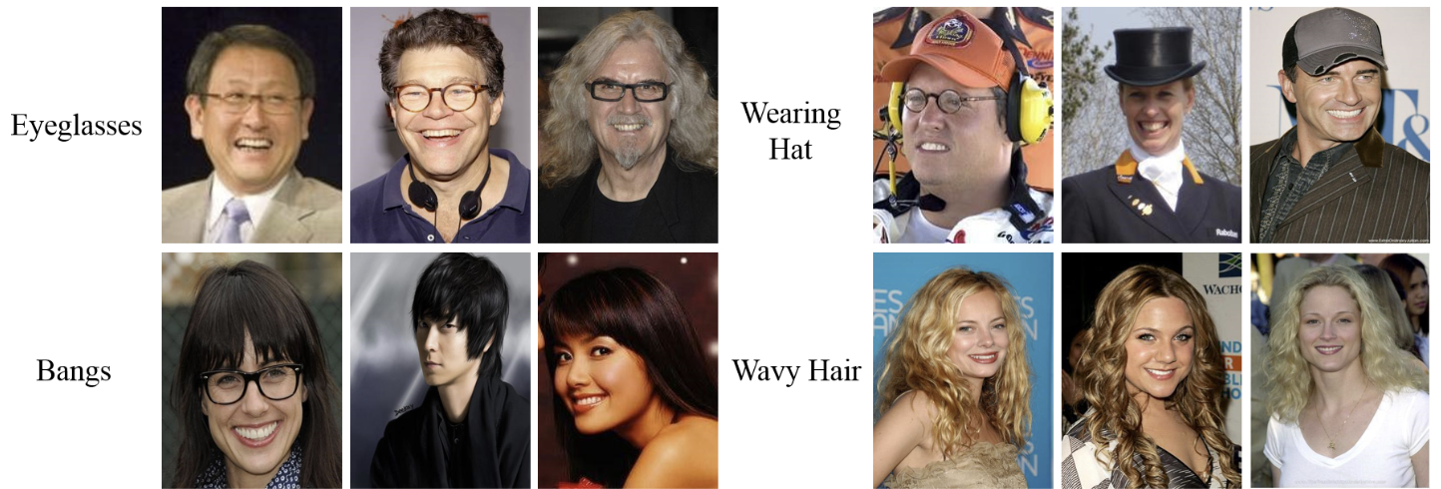
Dataset
CelebA dataset:
CelebA is a face attribute dataset with ~200K celebrity images, each with 40 attribute annotations
Open source link: https://mmlab.ie.cuhk.edu.hk/projects/CelebA.html)
In this project, we use 5000 images and their respective annotations of the CelebA dataset

Slide 5
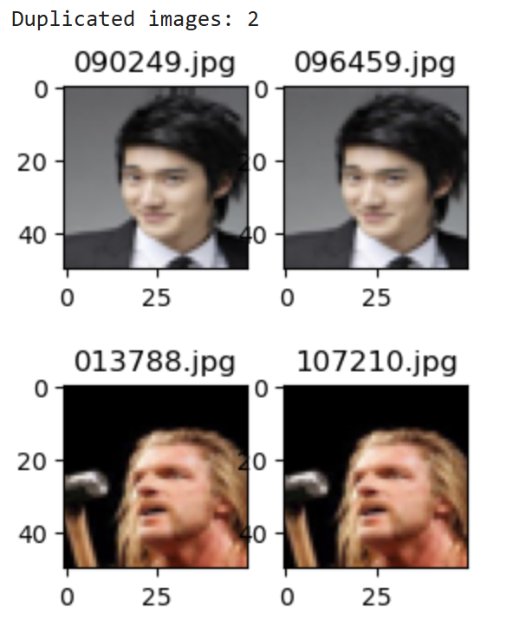
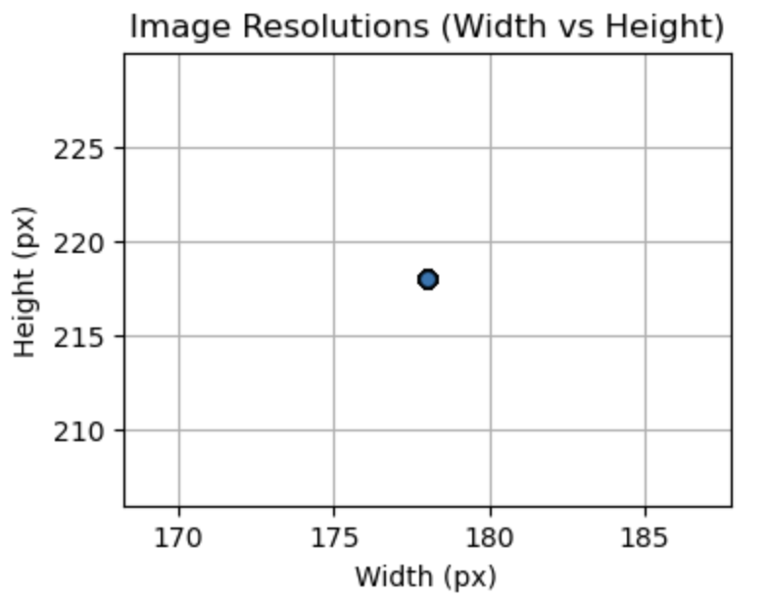
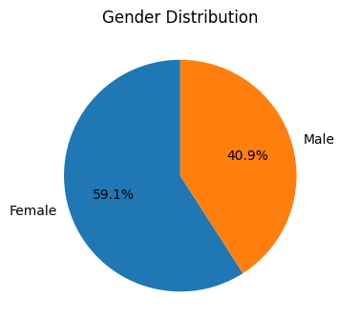
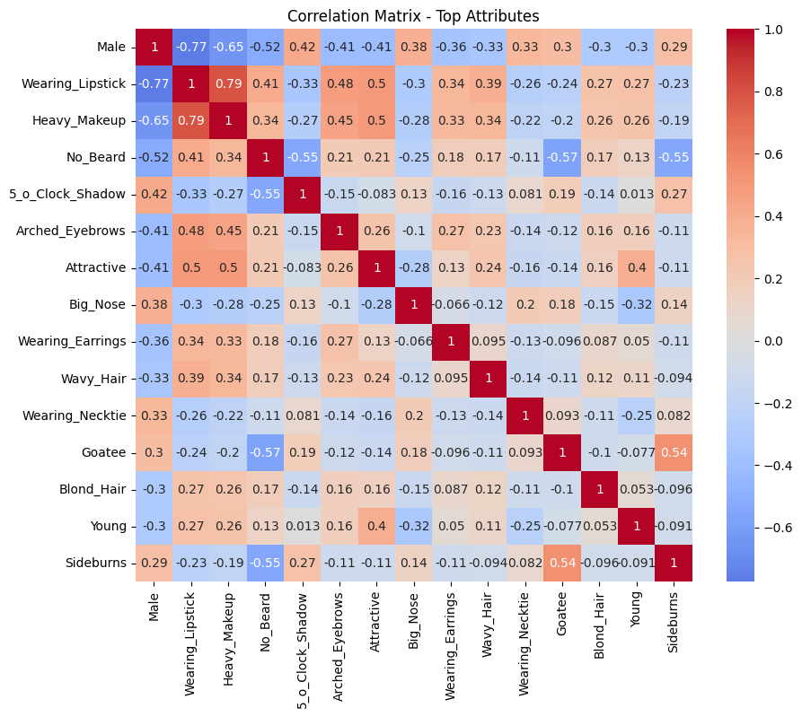
Dataset
Image Resolution
(Data Consistency)
Data Duplication
Label Distribution
Features Correlation Matrix

Slide 6
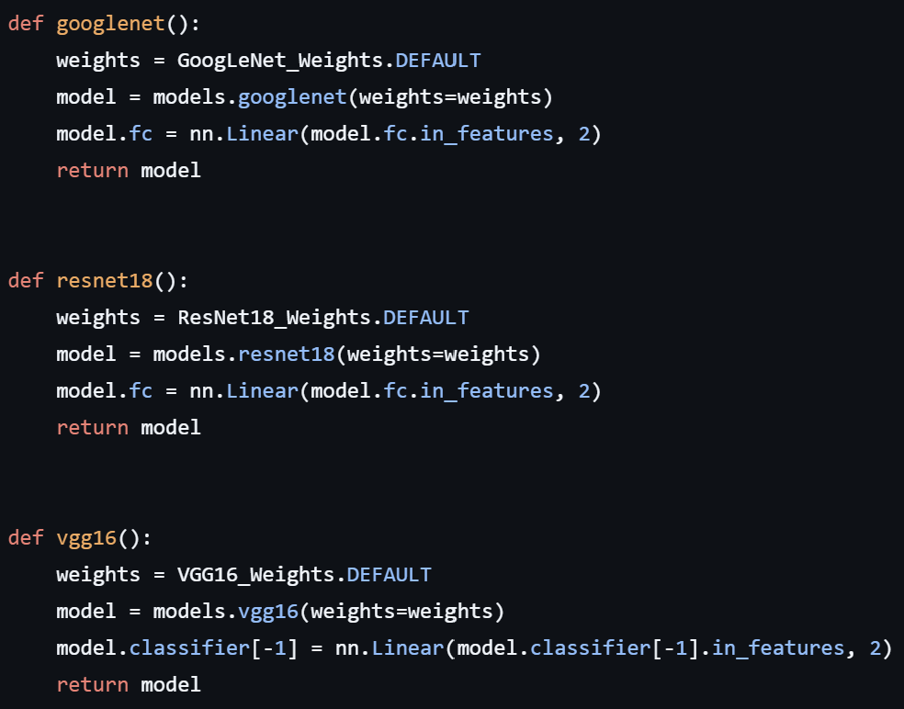
Model development
Load pre-trained models
Modify the last layer to predict two class (male or female)

Slide 7
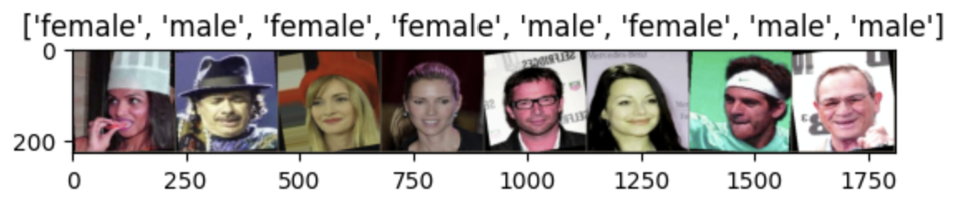
Training protocol
We split the dataset into training, validation, and test sets using a 70/15/15 ratio, resulting in 3500 images for training, 750 for validation, and 750 for testing.
Data augmentation:
RandomRotation(10)
RandomHorizontalFlip()
ColorJitter(brightness, contrast, and saturation = 0.2; hue = 0.1)

Slide 8
Training protocol
Hyperparameters used:
Weights are saved whenever the model reaches its best validation accuracy
Hyperparameter | Value
Epoch | 30
Batch size | 32
Learning rate | 0.0001
Criterion | CrossEntropyLoss
Optimizer | Adam

Slide 9

Evaluation metrics

Slide 10
CNN Architecture Comparison
Models with different CNN Architectures, trained with Dataset 5K Images
Model State File | Description
resnet_5k_best.pth | ResNet18
resnet_pt_5k_best.pth | ResNet18 pretrained with ImageNet Dataset
googlenet_5k_best.pth | GoogleNet
googlenet_pt_5k_best.pth | GoogleNet pretrained with ImageNet Dataset
vgg_5k_best.pth | VGG16
vgg_pt_5k_best.pth | VGG16 pretrained with ImageNet Dataset

Slide 11
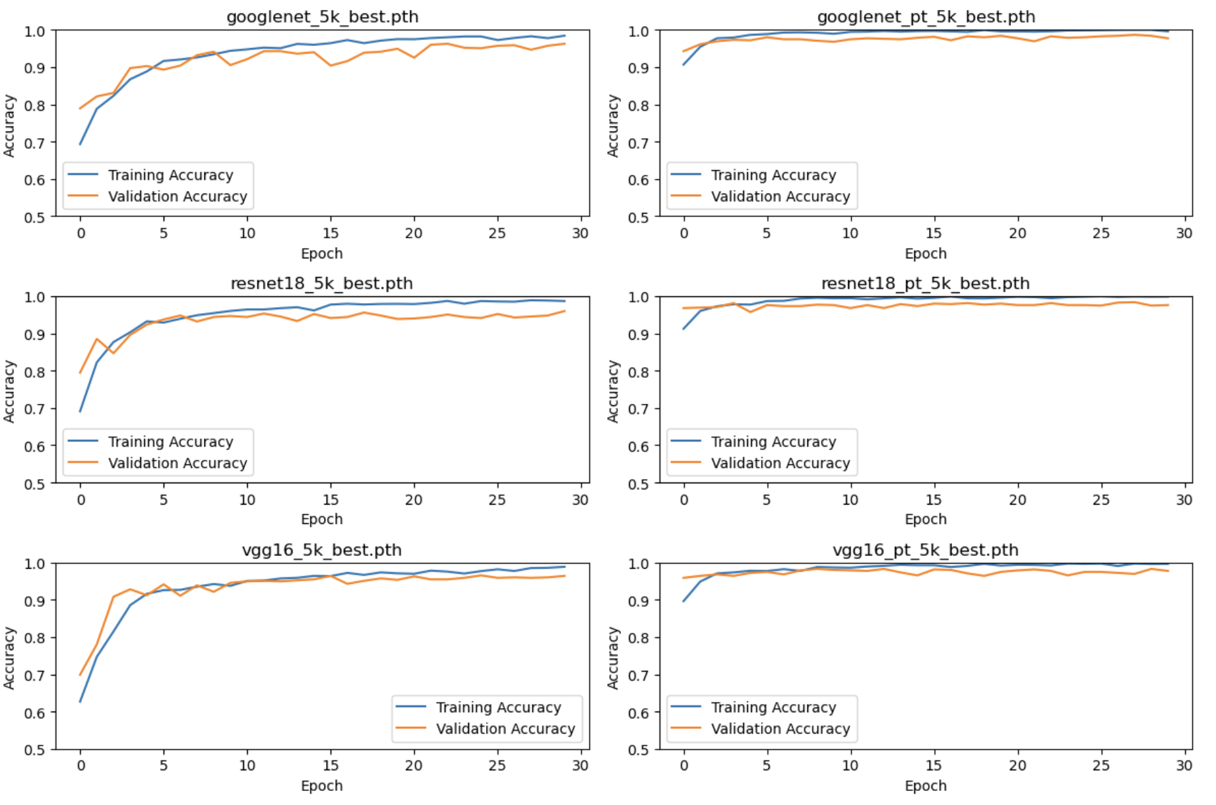
Training and Validation Accuracy
There is no indication of overfit using hyperparameter with Epoch 30

Slide 12
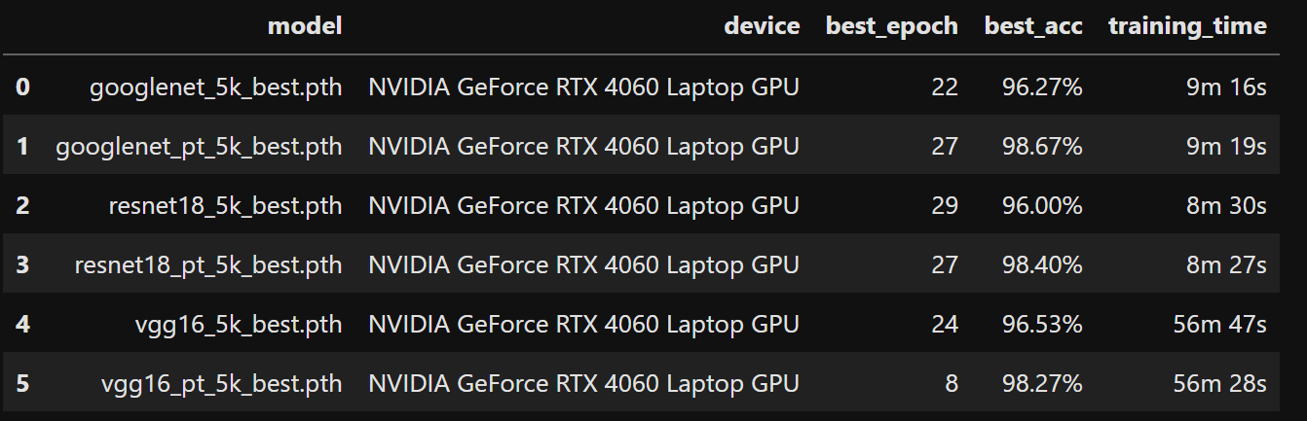
Training Result Summary
All models are having good accuracy but VGG need more training time compare to others

Slide 13
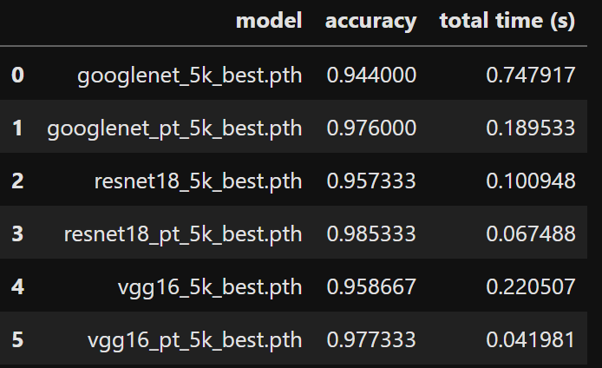
Evaluation Result
Prediction Accuracy and Time
We use the saved model to predict 750 images using GPU NVIDIA GeForce RTX 4060 Laptop GPU
Prediction time of Pre-Trained Model is better than Default Weight Model

Slide 14
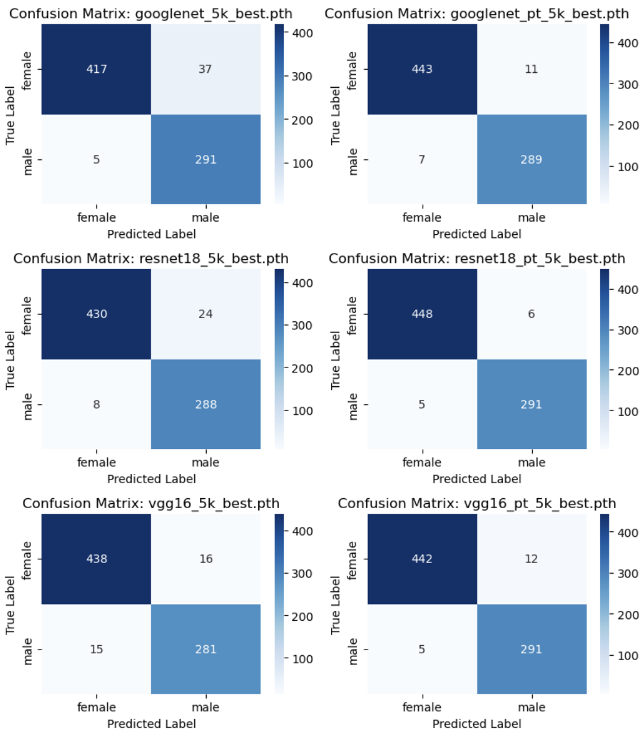
Evaluation Result
Classification Report (Weighted Average)
Confusion Matrix
Number of Samples: 750,
with Female: 454 and Male: 296
Weighted Average will be used for Classification Report for Class Imbalance dataset
Model | Precision | Recall | F1-Score
googlenet_5k_best.pth | 0.948307 | 0.944000 | 0.944413
googlenet_pt_5k_best.pth | 0.976113 | 0.976000 | 0.976027
resnet18_5k_best.pth | 0.958585 | 0.957333 | 0.957512
resnet18_pt_5k_best.pth | 0.985346 | 0.985333 | 0.985338
vgg16_5k_best.pth | 0.958694 | 0.958667 | 0.958679
vgg16_pt_5k_best.pth | 0.977599 | 0.977333 | 0.977378

Slide 15
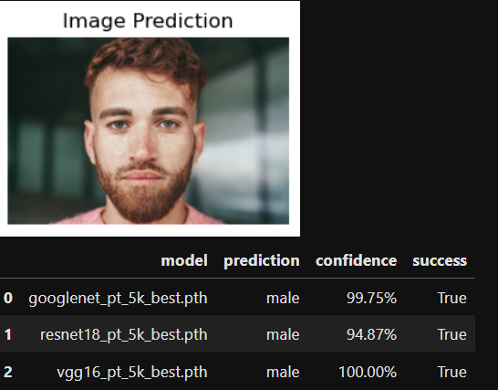
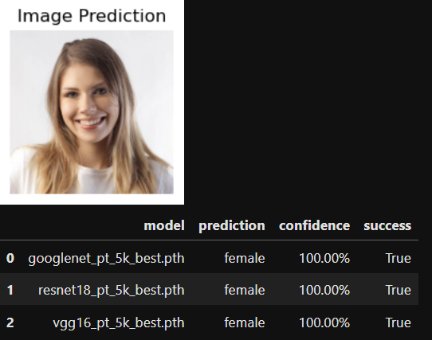
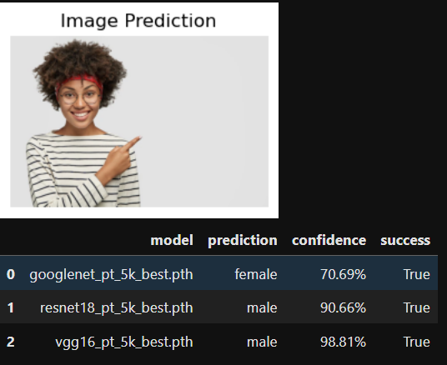
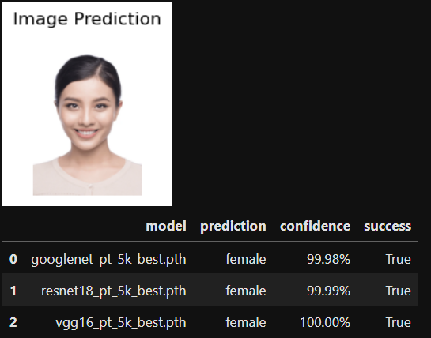
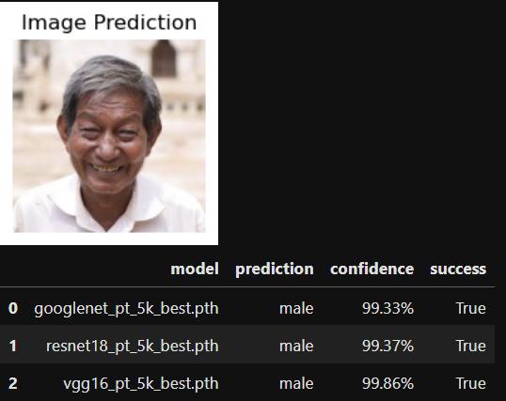
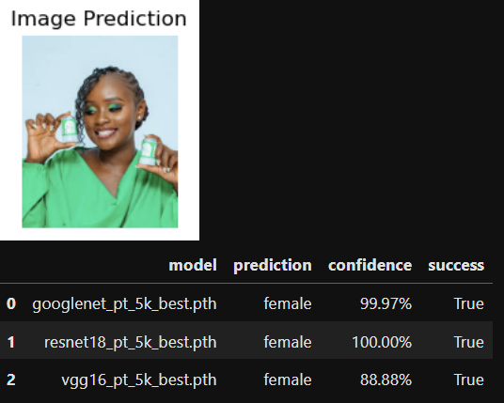
Prediction Test

Slide 16
Conclusion
There is no indication of overfit using hyperparameter with Epoch 30
Prediction time of Pre-Trained Model is better than Default Weight Model
Model menghasilkan terbaik menggunakan Resnet : Akurasi 0,98533, Precision 0,985346 , Recall 0,985333, F1-Score 0,985338.

Slide 17
Future improvement
Increase dataset size from the CelebA dataset
Experiment with augmentation methods tailored specifically for gender classification
Explore alternative transfer learning techniques, such as freezing weights in different layers

Slide 18


